Slide 1
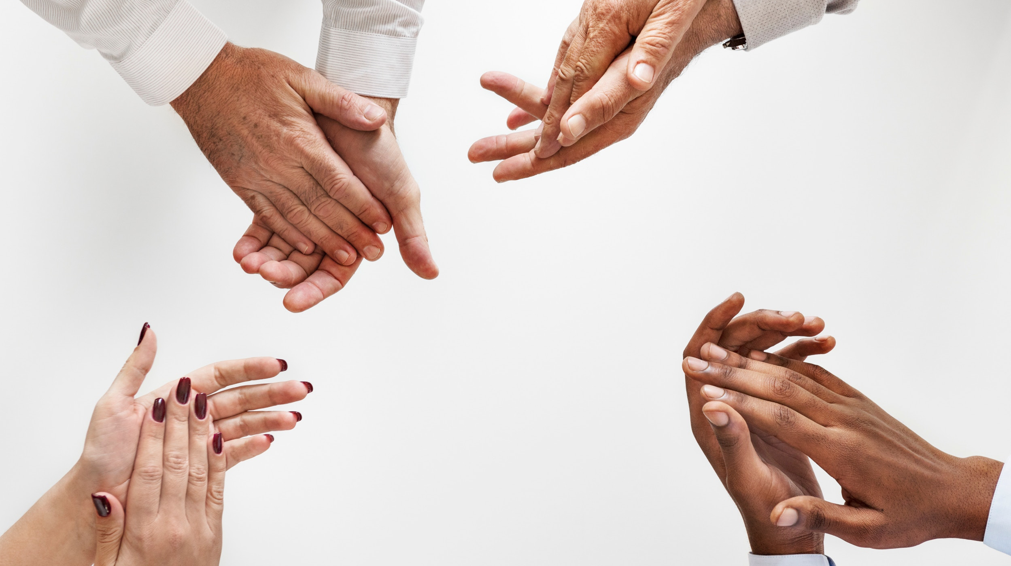

Sign Language Recognition
Video Understanding through Deep Learning Frederik Schorr | July 2018
Photo by rawpixel on Unsplash

Slide 2
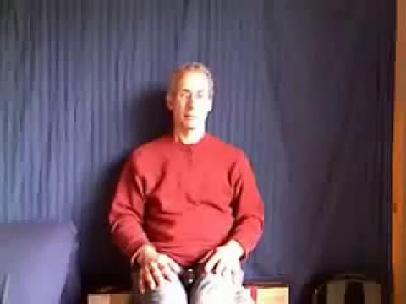
Sign Language for Deaf People
~1-3 deaf in 1.000 people in Europe ~700.000 - 2.1M
Different sign languages all over the world, own grammar & syntax
Complex body movements, the „flow“ is essential, not only static signs
Communication restricted to small group of like-minded, relatives and teachers
My wife teaches with signs
Project Idea: Tablet that Translates Sign Language

Slide 3

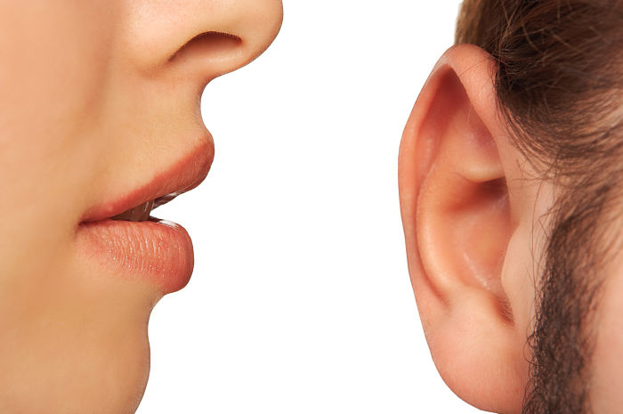
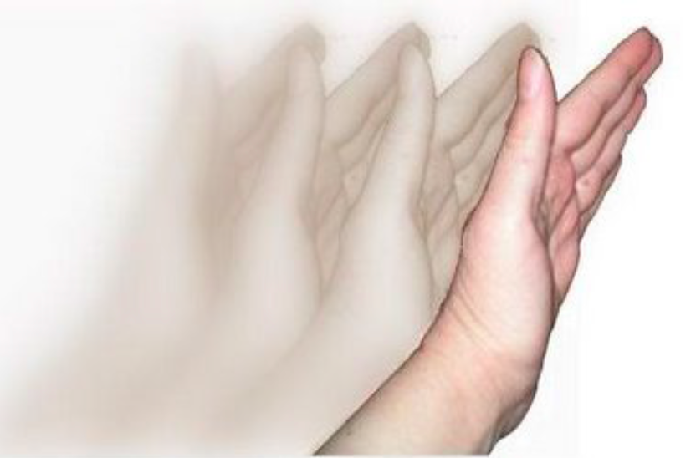

Focus: Recognise Gestures = Video Classification
“Natural” Language
Sign Language
Speech Recognition
= Solved
Understanding gestures too complex – until very recently!
Live-demo: prototype recognising isolated gestures of ~5 sec

Slide 4

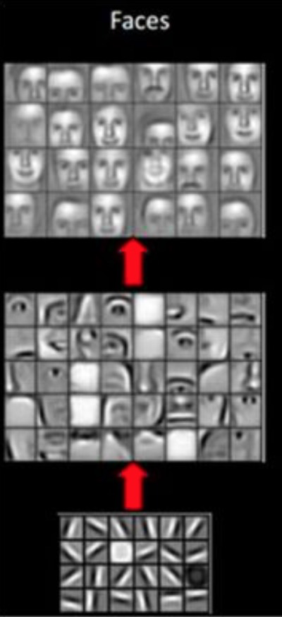
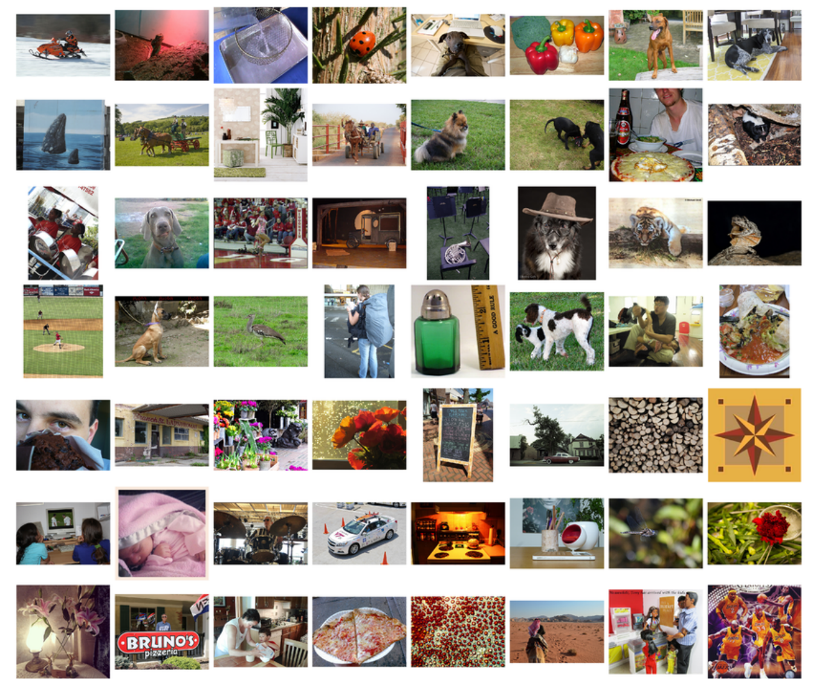
State-of-the-Art: Image Understanding Solved with Deep Learning
Convolutional Neural Nets Learn Hierarchical Features
1000 object categories
1.2 million training images
Classification Error in 2017: 2.3%⁽¹⁾
Transfer Learning!
Convolutional Neural Networks trained on ImageNet can be used to extract image features, eg eyes, corners, …
Can easily be re-used for any image classification - not only on 1000 standard categories
Enables extremely powerful transfer learning (analogous to human brain)
⇒ Fuels current AI hype
(1) http://image-net.org/challenges/LSVRC/2017/

Slide 5
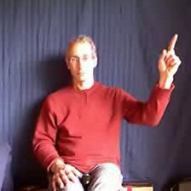
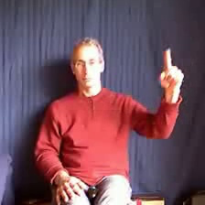
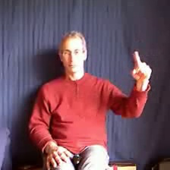
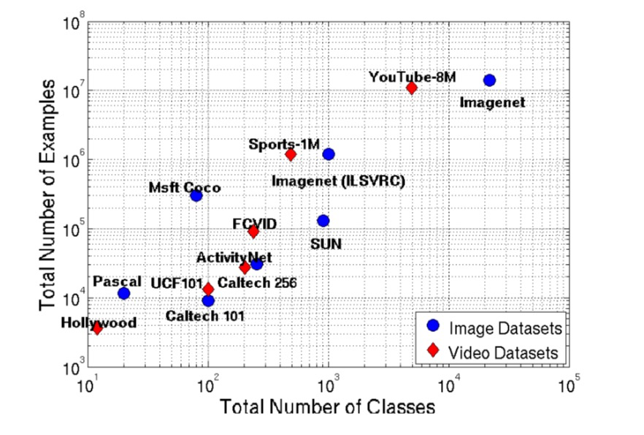
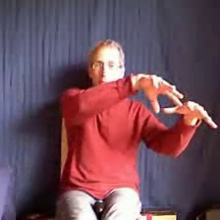
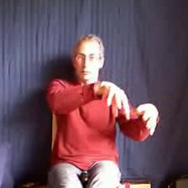
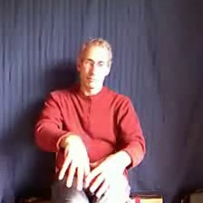
Video Adds Time Dimension ⇒ Much Harder !
Short-term: Detect “Flow” of Movement
Required Large-Scale Video Datasets⁽¹⁾ only Emerging Since 2016
(2016)
(2014)
20BN Jester (2017)
Kinetics
(2010)
Long-term: Remember Sequence (eg first lightning then rain)
(2017)
(2015)
Subset of 20 Italian sign language gestures used for this prototype
(2015)
ChaLearn249 (2016)
(2012)
(1) Figure from YouTube-8M: A Large-Scale Video Classification Benchmark, Google Research, Sep 2016. Enriched with additional video datasets.

Slide 6
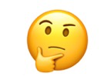
1st Prototype: ImageNet Transfer Learning + Memory Unit
1st
3. Feed the image features (sequentially) into Long-Short-Term-Memory
Good result on proof-of-concept: ~70% accuracy on UCF101⁽¹⁾ human action video dataset (~10 sec each)
But not satisfying on short-term movements required for sign language. Only ~40% accuracy on gestures from ChaLearn20⁽²⁾ ...
🤔
40
...
...
1024 x 1
01
LSTMs
Gesture
CNN
2. Extract image “features” from CNN “MobileNet” pretrained on ImageNet
CNN
...
CNN
...
Video Frames 224x224
40
...
01
time
1. Slice video into 40 frames
(1) UCF101 dataset consists of 101 human actions (eg badminton, applying lipstick) and 13.000 videos
(2) ChaLearn dataset consists of 249 human gestures and 50,000 videos. For this prototype 20 mostly Italian sign language gestures were used (3200 videos)

Slide 7
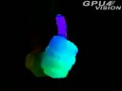

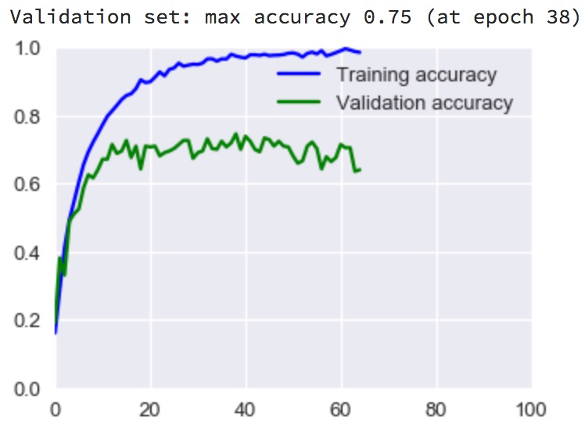
1st Try: “Optical flow” Boosts Short-Term Movement Detection
2nd
Optical flow (instead of “normal” frames) increases accuracy on ChaLearn20 above 70% 😀
epochs
Calculated from 2 successive frames
Computationally very expensive!

Slide 8
1st Solution = State-of-the-Art: Pre-Trained 3D-CNN from Deepmind
3rd
3D-CNN add time as 3rd dimension to “classical” image CNNs (with 2D) ⇒ very complex models
In 2017 Deepmind published I3D⁽¹⁾, which is “inflated” from the famous 2D-“Inception” CNN
I3D inherits pretraining from ImageNet + is pretrained on Kinetics human action video dataset
Pretrained I3D can be used for transfer learning!
Gesture
93%
Accuracy on ChaLearn20 gestures
⁽²⁾
3D-CNN
...
...
Optical Flow 224x224
40
time
...
01
(1) Quo Vadis, Action Recognition? A New Model and the Kinetics Dataset, J Carreira, A Zisserman, Deepmind, 2017. Keras version available since 2018 https://github.com/dlpbc/keras-kinetics-i3d
(2) ChaLearn249 is very hard challenge because val/test sets are performed by “new” signers. Highscore in Summer 2016 competition was “only” 57% on test. My I3D network achieves 58% on val set :)

Slide 9


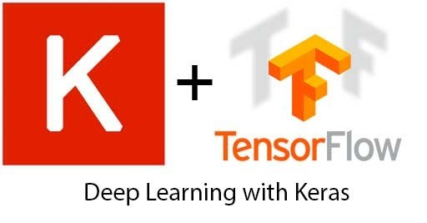


Live-Demo of Sign Recognition Prototype
All training of neural networks on Amazon cloud with GPU
Live-demo on MacBook Pro i5 (no GPU)
Using 20 Italian sign language gestures (3.200 videos) from ChaLearn dataset
Prototype captures video (5 sec) from attached webcam, displays optical flow (~5 sec) and predicts gesture with I3D neural network (~5 sec)
https://github.com/FrederikSchorr/ sign-language

Slide 10
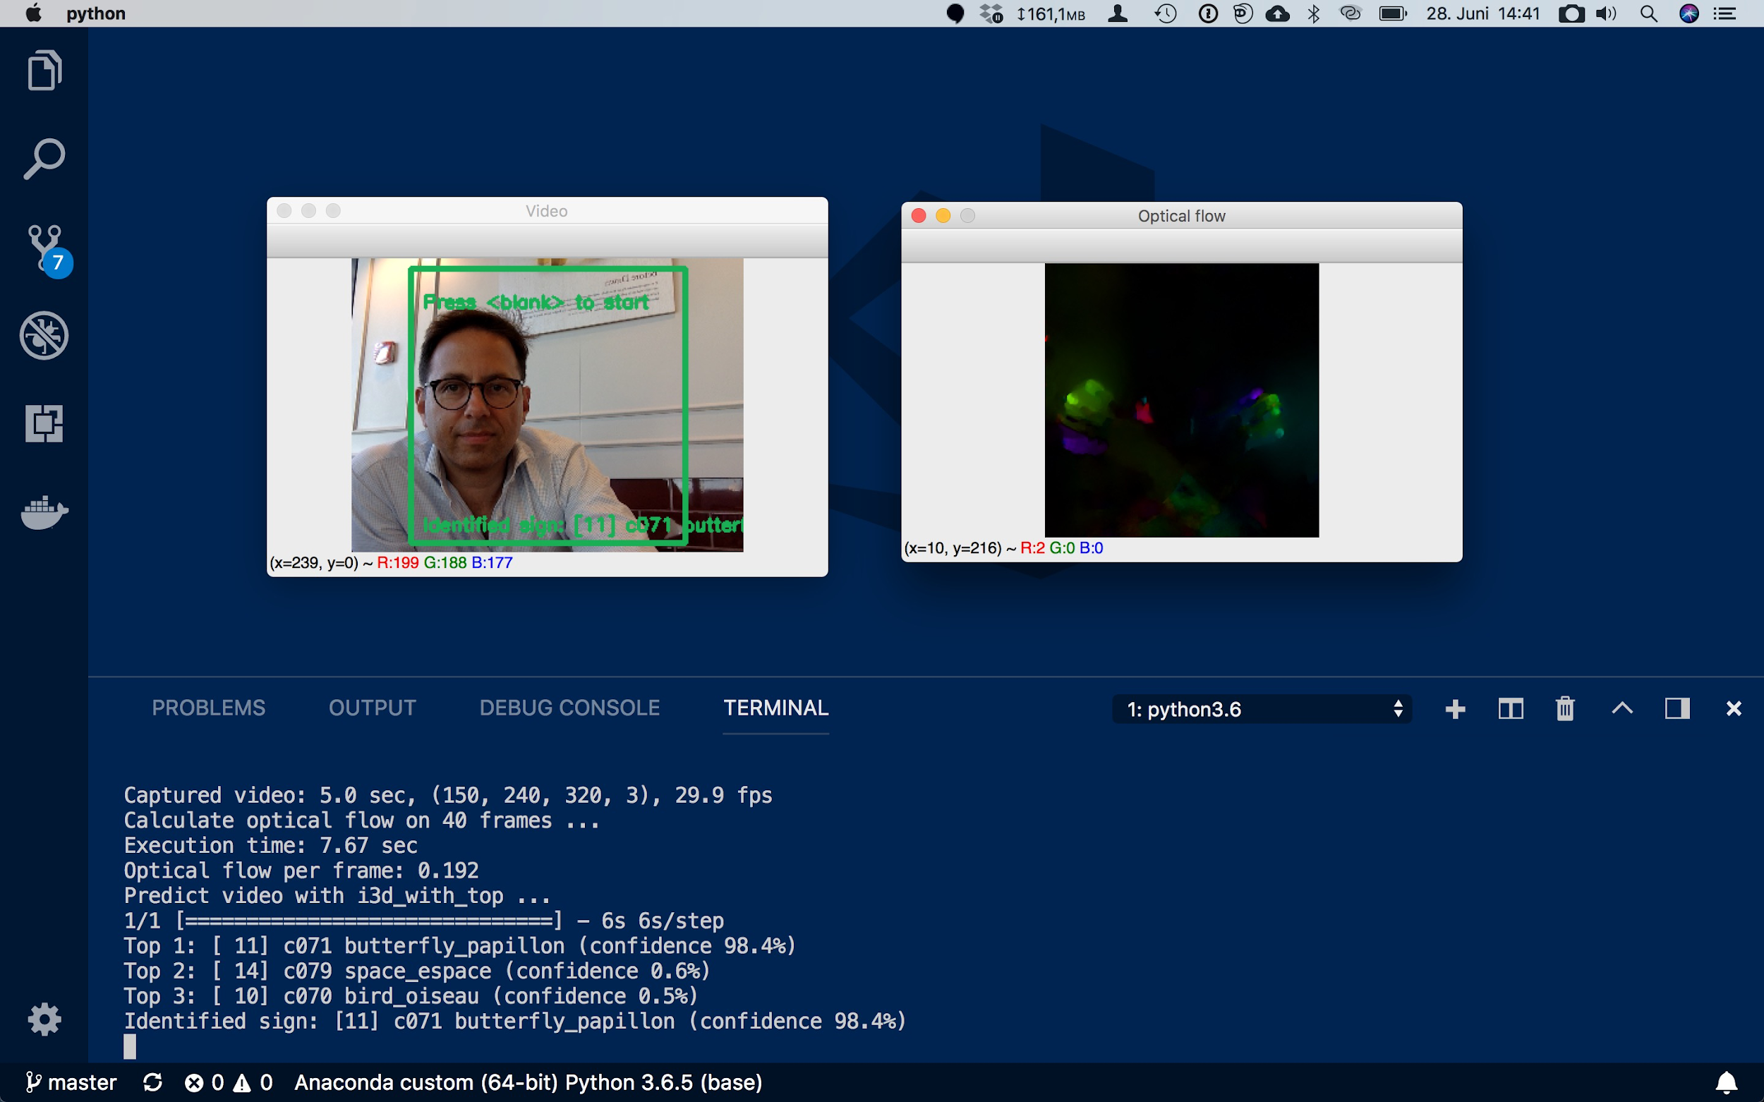
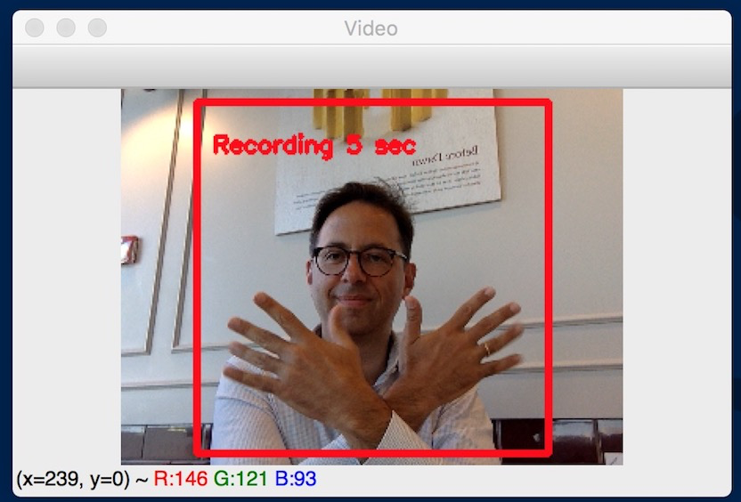
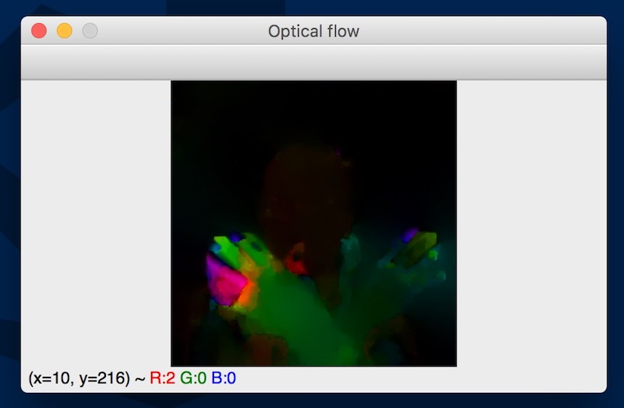
Sign Language Recognition Prototype: Screenshot

Slide 11
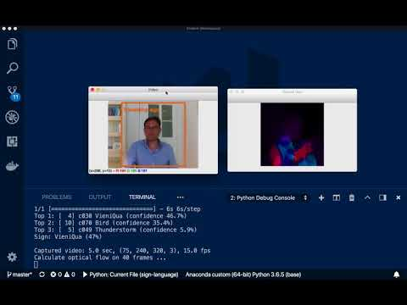
Sign Language Recognition Prototype: 1 min Video

Slide 12
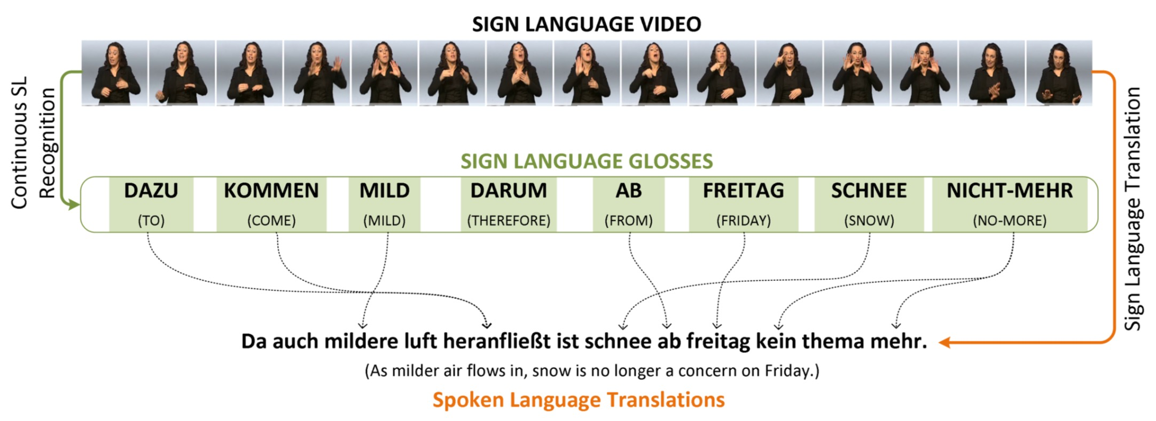
Future: From Sign to Sentence
New end-to-end approach: Sign Language Translation⁽¹⁾ merging video recognition with NLP⁽²⁾
Historically: Isolate signs in video stream, then translate 1-by-1
Anybody interested in making this happen?
(1) Figure from Neural Sign Language Translation, Necati Cihan Camgoz, Simon Hadfield, Oscar Koller, Hermann Ney, Richard Bowden, 2018. (2) Natural Language Processing

Slide 13
(Almost) No Large-Scale Sign Language Datasets Available
Backup
Phoenix Weather by RWTH Aachen | Based on 2009-2011 weather forecast on german TV Isolated gestures and whole annotated sentences 7 signers, very homogenous TV setting
ChaLearn by Barcelona University | 249 (isolated) human gestures, 50.000 videos 21 signers, heterogenous background settings Validation/test set performed by “new” signers ⇒ very hard challenge Subset of 20 Italian sign language gestures used for this prototype
LedaSila by Alpen Adria Universität | Lexicon for Austrian sign language, 16.000 signs, 33.000 videos Most words occur only once, only 10 words occur more than 20 times ⇒ not enough for neural network training
20BN Jester by twentybn.com | 27 human gestures, 150.000 videos Similar to sign language gestures - but with very low complexity
Sign language on public TV | Several public tv stations offer sign language streams with subtitles These could probably be scrapped ⇒ separate project

